Slide 1
DNN Performance & Scalability
Planning, Evaluating & Improving : Part 2

Slide 2
Agenda
Moving Past Configuration
Proactive & Reactive Performance Optimization
How the Web Works
Fiddler
Improving Client Side
Client Resource Management
Fiddler
Google PageSpeed

Slide 3
Survey Time!
Those on Shared Hosting?
Those on Azure Websites?
Those on Dedicated/Virtual Machines?
Those on Load Balanced Environments?

Slide 4
Moving Past Configuration
First step is always to validate the basics
Properly configured site, with proper hosting
Then, move forward
Define goals for performance optimization
__ Users Concurrently
__ Score on ____ Tool
Average page load time under ___ seconds for all users
Etc.
Define the scope of any testing, what can or cannot be changed

Slide 5
Proactive vs. Reactive Performance
Understanding concepts are integral to success
Proactive Teams
Have well defined tests
Test often, and regularly
Can identify issues quickly, and adapt to issues with less effort
More methodical approach
Reactive Teams
Often rushed
Only test after catastrophy has occurred
Are often side-tracked with

Slide 6
Understanding The Web
The flow to load the homepage of a site
1 Request = Homepage HTML
Browser Processes HTML
Loads additional Images, CSS, JS, etc
Only 4-10 items at a time, per domain
Page rendered to the user
Due to the 4-10 limit, delays can stack
Average Sites HTTP Requests
CNN.Com > 220
Microsoft ~ 46
IowaComputerGurus.com ~ 15

Slide 7
Key To Visualize This
Fiddler
Free utility
www.getfiddler.com

Slide 8
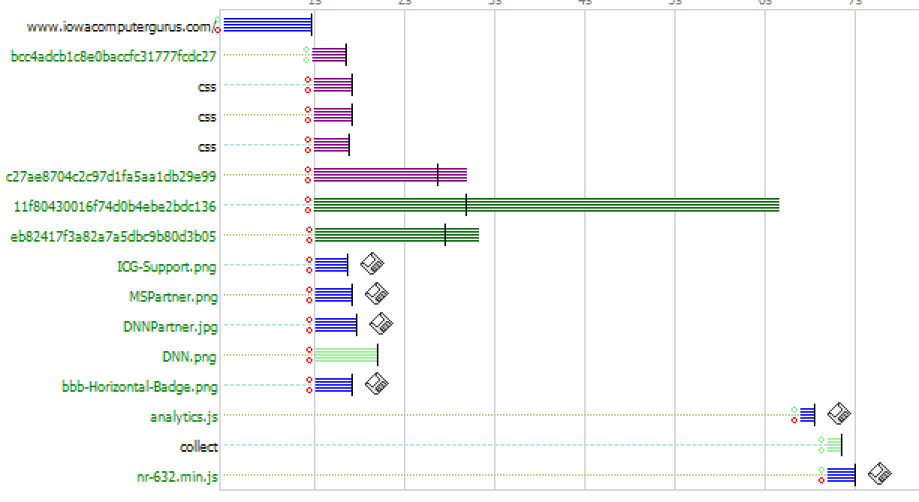
Timeline Visualization: My Site (15 Requests)

Slide 9
Timeline Visualization: DNN Corp (129 Requests)

Slide 10
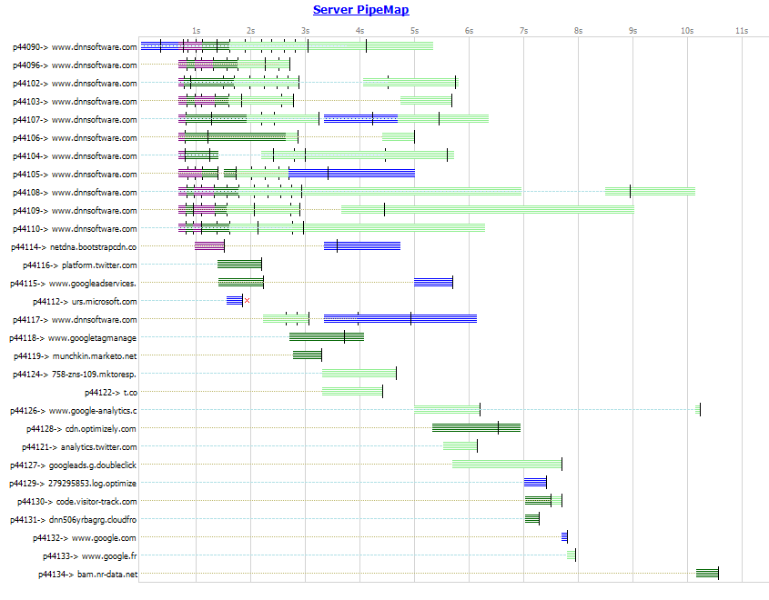
Pipe View

Slide 11
Google PageSpeed Insights
Free Online Utility: http://tinyurl.com/m65jex6
Uses key metrics per google, scores on Mobile, Desktop, and Mobile Usability. All scores out of 100.
Metric | ICG | DNN Software
Desktop | 89/100 | 77/100
Mobile Speed | 74/100 | 56/100
Mobile Usability | 100/100 | 98/100
High Issues (Desktop) | None | Eliminate Render Blocking JS
Medium Issues (Desktop) | Render Blocking JS, Image Compression | Almost all

Slide 12
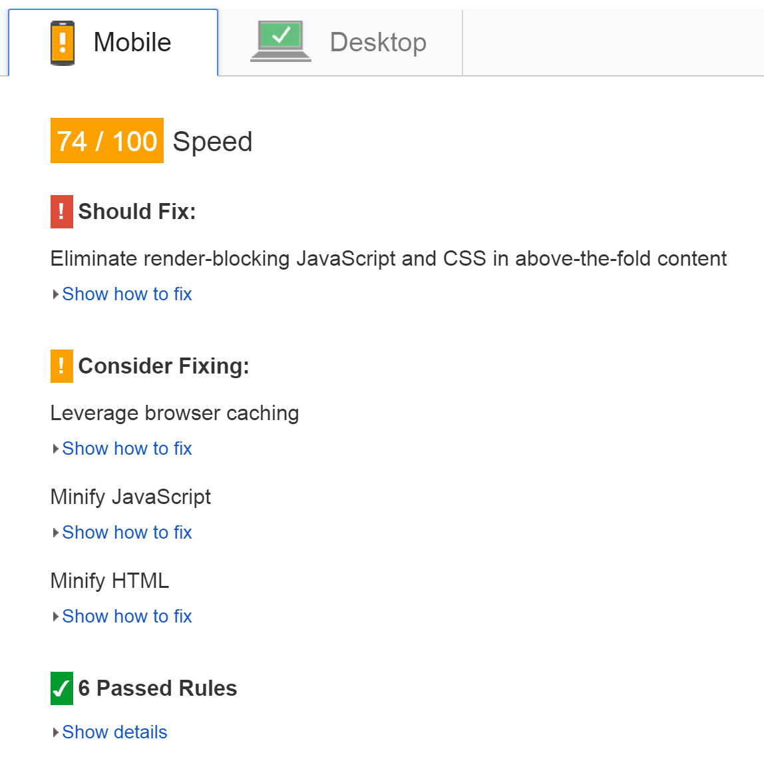
Example Result

Slide 13
What Does This Tell Us?
Server Response Time > 0.2 seconds results in a “finding”
Finds images needing compression
Finds larger images
Identifies issues with caching/compression
Layout & usability issues (high level)
Key finding: Make google happy, and the results can be huge!
But How?

Slide 14
Lets Make Client Side Better
Client Resource Management
This is a key for situations where your skin & modules support it.
IowaComputerGurus.com lost more than 40 HTTP requests by enabling
Content Delivery Network (CDN)
Requires manual changes but has multiple benefits
Using a different domain, can multiplex requests with other domains
Offloads traffic to other servers, limiting impact to the webserver
BudgetChallenge.com – Gained more than 300% Throughput with this change alone
Image Compression & Optimization
Compresspng.com etc.

Slide 15
Moving Past: Apply Load
Only after optimizing the simple stuff can we move on.
Next steps are to use load to simulate/stress to see where things get congested.
Process is KEY
Determine the Environment
Setup a Plan
Setup Monitoring
Execute
Evaluate

Slide 16
Load Testing: The Environment
Where do you test?
Can the issue be recreated on a dev environment?
Yes
Great, test on dev!
No
Further considerations need to be taken
Can you test on production?
Yes, but ideally you want to do what you can to isolate items to better test, as there is overhead
Some ASP.NET performance items can be identified in production, however, changing things to test might not be feasible

Slide 17
Load Testing: Environment Cont.
Make sure it is similar to the real environment
Similar CPU + RAM
Similar Disk IO processes
Similar Configurations of Servers
Similar OS Versions & Editions
If changing load or specs be aware of items approaching limits
Example: Using a dual core SQL Server box in dev and a quad core in production

Slide 18
Load Testing: The Plan
Develop a consistent plan for analysis
Based on user interactions not the “Developers Use”
Based on specific scenarios
Must be realistic
Ensure that your test duration is long enough
Too short – Limits effectiveness of testing
Too long – could show false “issues”
Watch for warm vs. cold worker processes
Ensure that the test itself is realistic
Don’t just test .aspx pages and neglect the other resources
Don’t forget about Notifications
Tell the hosting company etc BEFORE testing

Slide 19
Load Testing: Monitoring
Key is to have consistent monitoring tools & metrics available. I personally prefer NewRelic, but others are ok.
Look to monitor at a minimum
Web Server
Disk IO, Requests/Sec, CPU Usage, Memory Usage
Database Server
Disk IO, CPU Usage, Memory Usage, SQL Connections Open,

Slide 20
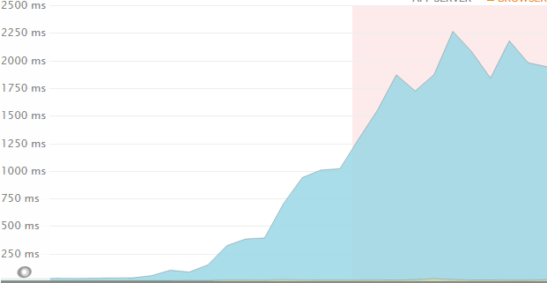
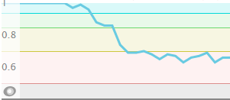
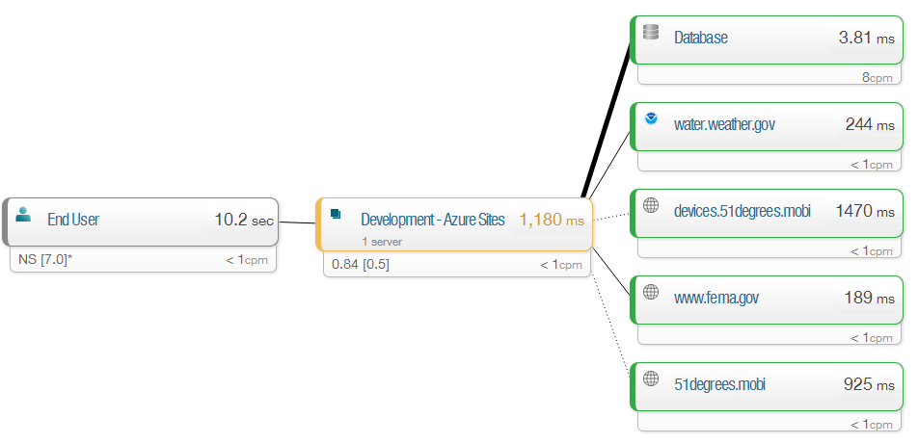
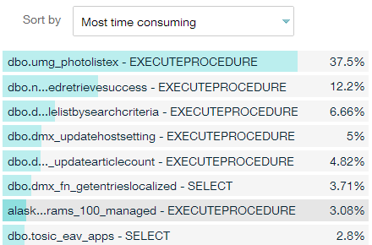
Examples of Data: NewRelic

Slide 21
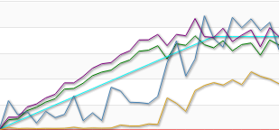
Execute Your Test
Configure to be repeatable
Test ALL content not just .aspx
I use LoadStorm.com, you can use what you want
Be sure to retain configuration & planning though for future execution

Slide 22
Evaluate and Retest
Look at ALL results before acting
Remember the scientific method and get ready to retest after 1 CHANGE!

